Slide 1

X⁴ → Y¹⁴ → ENGINE
SOVEREIGN ENGINE / MEANING LAYER
Geometry becomes an auditable meaning system
[
A reconstruction of the Geometric Unity transcript and repository—translated from tensor calculus and bundles into verifiable software operations.
Prepared by Manus AI Research architecture brief · 2026
Notes:
Welcome everyone. Today we are looking at a reconstruction of the Geometric Unity transcript and the Sovereign Engine repository. We are translating complex tensor calculus and fiber bundles into verifiable software operations. Let's examine how geometry becomes an auditable meaning system.

Slide 2

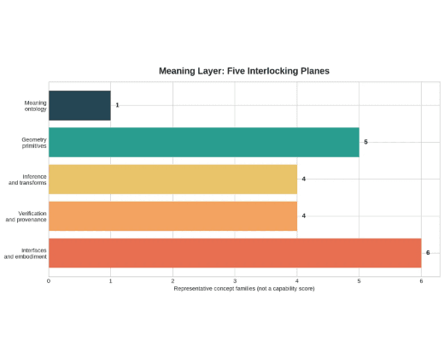
01 / PROJECT IDENTITY
The project is four systems at once
01 · RUNTIME
Geometry-native AI runtime
State and reasoning are represented as constrained geometric objects and transformations.
02 · KERNEL
Verifiable knowledge kernel
Conceptual model of the five interlocking planes; values are representative concept-family counts, not a capability score.
Objects, relations, transformations, identities, and validation gates are explicit.
03 · TRANSLATION
Cross-domain translation platform
Language, science, music, data, and embodied systems are mapped through shared invariants.
04 · EMBODIMENT
Interactive meaning surface
Visualizers, games, dashboards, audio, and hardware make hidden structures perceptible.
SOVEREIGN ENGINE / 02
Notes:
The Sovereign Engine is not just a single tool. It operates as four distinct systems at once. We built a geometry-native AI runtime, a verifiable knowledge kernel, a cross-domain translation platform, and an interactive embodiment layer. Building on our introduction to auditable geometry, these four systems let us represent abstract states, preserve validation gates, translate across domains, and render hidden structures perceptible. Let's look at how the underlying geometric arena is constructed.

Slide 3

02 / GEOMETRIC UNITY
What the count means
GU changes the arena, not just the equation
Mathematical: a bundle total-space dimension.
dim Sym²(T*X⁴) = 4(4+1)/2 = 10 dim Y¹⁴ = 4 + 10 = 14
Not established: a demonstrated 14-dimensional physical universe or Standard Model derivation.
Engine translation: a typed state space that preserves base, fiber, projection, and observation context.
A classical four-dimensional base is paired with the independent components of a local symmetric metric. The construction preserves the relationship between an observable point and the possible geometries above it.
SOVEREIGN ENGINE / 03
Notes:
Geometric Unity changes the arena of physics, not just the equations within it. We start with a classical four-dimensional base space and pair it with the ten independent components of a local symmetric metric. This gives us a fourteen-dimensional total space. Remember that this fourteen-dimensional count is mathematical structure from bundle theory. It is not an established proof of a fourteen-dimensional physical universe. The engine uses this typed state space to preserve base, fiber, and observation context. Let's see how the observer fits into this structure.

Slide 4

Software consequence
03 / OBSERVERSE AS STRUCTURE
The observer is a relationship package
Preserve context. A projection is not the whole object; retain the base, fiber, map, local coordinates, and provenance.
X
Fₓ
σ
∇
π*
O
→
metric fiber
→
→
→
→
Make transport explicit. Every update or translation carries the connection or transformation that relates one local state to another.
base point
section
connection
pullback
observation
The transcript’s observer is not merely a point in the total space. It is the coordinated package of spaces, fibers, sections, transport rules, and projections that determines what can be represented and what can be seen.
Separate fact from analogy. The bundle vocabulary is standard mathematics; its role as a meaning engine is a project-level interpretation.
SOVEREIGN ENGINE / 04
Notes:
In this framework, the observer is never just a passive point in space. It is a complete relationship package linking base points, fibers, sections, connections, pullbacks, and observation maps. A projection is never the whole object by itself. We must preserve its context and gluing rules. The software translates this by keeping track of local coordinates and provenance for every projection. While standard mathematics gives us the bundle vocabulary, using it as an engine for meaning is our project-level interpretation. Let's examine the tensor calculus that supplies our physical vocabulary.

Slide 5
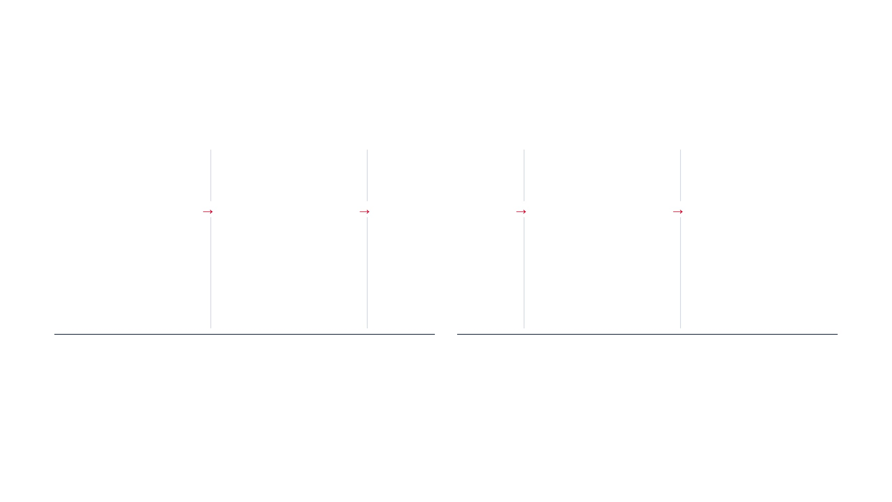
04 / TENSOR CALCULUS
Tensor calculus supplies the physical vocabulary
Each object answers a different question about geometry; the Engine must preserve those distinctions rather than collapse them.
g
_{μν}
∇
R
T
K
Metric
Connection
Curvature
Torsion
Contortion
PHYSICAL QUESTION
→
PHYSICAL QUESTION
→
PHYSICAL QUESTION
→
PHYSICAL QUESTION
→
PHYSICAL QUESTION
What counts as length, angle, causal direction, and volume?
How are vectors compared or transported between nearby points?
Does transport depend on the path around a loop?
Does the connection reproduce the bracket of directions?
How does a general connection differ from Levi–Civita?
ENGINE ANALOGUE
ENGINE ANALOGUE
ENGINE ANALOGUE
Accumulated geometric inconsistency.
ENGINE ANALOGUE
ENGINE ANALOGUE
Coordinate and metric context for a state space.
Typed transition and transport rule.
Noncommutative or displacement defect.
Explicit deformation tensor with provenance.
ESTABLISHED MATHEMATICS
PROJECT INTERPRETATION
Metric, connection, curvature, torsion, and contortion are distinct objects with distinct index structure and rules.
Sovereign Engine turns each object into a typed state, registered operation, invariant check, and replayable record.
SOVEREIGN ENGINE / 04
Notes:
Tensor calculus gives us the exact physical vocabulary we need. Each object answers a different geometric question. The metric defines length, angle, and volume. The connection handles transport between nearby points. Curvature measures path dependence, while torsion and contortion track non-Levi-Civita deformations. While these objects are established mathematics, our engine turns each one into a typed state, a registered operation, an invariant check, and a replayable record. Let's look at how this tensor vocabulary builds into a testable chain of curvature.

Slide 6

Conservation is an invariant
05 / TENSOR CALCULUS
Curvature becomes a testable chain
∇ᵐGₘₙ = 0
→
→
→
The contracted Bianchi identity explains why the geometric side of the Einstein equation satisfies a divergence constraint. A variable vacuum term needs additional structure; it cannot simply replace a constant without changing the model.
Connection
Riemann
Contractions
Einstein tensor
Γᵨₘₙ
Rᵨₛₘₙ
Rₛₙ R = gᵐⁿRₘₙ
Gₘₙ = Rₘₙ − ½Rgₘₙ
Defines comparison and transport between nearby directions.
Measures path dependence of parallel transport.
Geometric source term in general relativity.
Reduce the 4-index tensor to summaries.
Physical significance
Engine significance
The chain turns a transport rule into curvature, then into the contracted object that enters the Einstein field equation.
Every contraction, convention, and numerical residual becomes an inspectable evidence record.
SOVEREIGN ENGINE / 06
Notes:
And now we trace how this vocabulary builds into a complete testable chain. We start with the connection, move to the Riemann tensor, and contract down to the Ricci scalar and the Einstein tensor. Notice the contracted Bianchi identity on the screen. It guarantees that the geometric side of the equation satisfies a divergence constraint. Our software doesn't just calculate these values. It records every single contraction, convention, assumption, and numerical residual into an inspectable evidence record. So when we look at conservation laws, we aren't relying on hand-waving. We are verifying structural invariants step by step. From here, we step down into gauge geometry to see how operator language operates inside the engine.

Slide 7

06 / GAUGE GEOMETRY
What each symbol means
Gauge geometry explains the transcript’s D² language
Potential · A A local rule for comparing or transporting gauge-valued states.
A ∈ Ω¹(X, 𝔤)
→
F = dA + A ∧ A
Field strength · F The nontriviality of that transport; a curvature 2-form.
Dω = dω + [A ∧ ω]
→
D²ω = [F ∧ ω]
DF = 0
→
Bianchi identity
Executable invariant The Engine checks degree, bundle, bracket convention, and the residual of DF=0.
The oral shorthand “D² becomes curvature” is best read as a typed operator relation: applying the covariant exterior derivative twice produces the curvature action on the representation carried by ω.
SOVEREIGN ENGINE / 07
Notes:
That brings us to the gauge geometry that explains the transcript's frequent D-squared language. When the transcript uses shorthand like D-squared becoming curvature, it is actually pointing to a typed operator relation. Here you see the gauge potential, the field strength, and the covariant exterior derivative mapped directly into executable code. When we apply that covariant derivative twice, the result naturally produces the curvature action on the representation. The engine checks the bundle, the degree, the bracket conventions, and the residual of the Bianchi identity as an active, executable invariant. We don't guess if the gauge field is closed or non-trivial; we compute the invariant directly. And that precision carries over when we look at spinors and spectral hypotheses.

Slide 8

07 / SPINOR AND SPECTRAL LAYER
UNRESOLVED GU CLAIM
Spinors and rolled-up complexes are hypotheses, not magic
Three generations require more than an operator
The transcript associates a special 14D truncation and a three-generation result with the rolled-up complex.
D̸ =
γ
^{μ}
∇
_{μ}
{γ
^{μ}
, γ
^{ν}
} =
2g
^{μν}
I
That association remains a hypothesis until the representation, action, boundary conditions, spectral calculation, and empirical bridge are all supplied.
𝒟 = [ 0 D* ; D 0 ] ⇒ 𝒟² = [ D*D 0 ; 0 DD* ]
Standard mathematics: a Dirac operator couples Clifford multiplication to a connection; a block operator packages even and odd sectors of a differential complex.
[
Engine meaning: represent the operator, its bundle, connection, boundary conditions, and spectral obligations as a replayable symbolic object—not as an automatic physical prediction.
SOVEREIGN ENGINE / 08
Notes:
Now we have to draw a hard line between standard mathematics and unverified physical hypotheses. The Dirac operator and the block operators shown here are well-established tools. They couple Clifford multiplication to connections and package differential complexes cleanly. But what the transcript claims about three generations and 14-dimensional truncations is a different story entirely. Those are hypotheses, not mathematical magic. The engine treats them as symbolic objects with specific representations, actions, and boundary conditions. If an ambitious spectral claim lacks an explicit representation or an empirical bridge, the engine flags it. We keep the math rigorous while refusing to smuggle in physical predictions without evidence. To maintain this discipline, the engine relies on a surprisingly small and trusted core.

Slide 9

08 / TRUSTED KERNEL
The Engine’s trusted core is small
The kernel does not need to know everything. It must make meaningful operations typed, replayable, and honest about unknowns.
01
02
03
04
05
06
Only three result states
Canonicalize
→
Type-check
→
Operate
→
Verify
→
Record
→
Explain
VERIFIED
Normalize symbols, units, coordinates, spans, and immutable IDs.
Validate manifold, rank, variance, signature, and bundle compatibility.
Apply a registered tensor, form, connection, projection, or transform.
Evaluate identities, residuals, assumptions, and tolerances.
Persist inputs, outputs, conventions, predicates, hashes, and provenance.
Expose the derivation graph and plain-language significance.
The operation and declared predicates replay successfully under the registered conventions.
FAIL
An invariant, schema, type, numerical tolerance, or replay check is violated.
What the kernel guarantees
What it refuses to infer
Deterministic canonicalization, index-safe contractions, registered ops, invariant checks, stable serialization, and replayable evidence.
Missing equations, unsupported predictions, unprovided representations, and semantic truth from proximity alone.
UNVERIFIABLE
The claim may be meaningful, but required equations, assumptions, or evidence are missing.
SOVEREIGN ENGINE / 09
Notes:
And that brings us to the design of the engine's trusted core itself. We designed this core to be intentionally small because it doesn't need to know every physical theory in existence. It just needs to make operations typed, replayable, and completely honest about unknowns. Every input goes through canonicalization, strict type-checking, registered operations, invariant verification, and immutable record-keeping. The core only ever yields one of three statuses: verified, fail, or unverifiable. There are no silent guesses and no hand-waving allowances. If the required evidence or assumptions are missing, the system tells you so plainly. This architecture turns abstract tensor equations into robust software contracts that you can audit, test, and trust.

Slide 10

Every response carries evidence
08 / SOFTWARE CONTRACTS
APIs turn equations into contracts
operation_id inputs · outputs assumptions · predicates canonical_hash source_refs · limitations
POST /manifolds
Register X⁴ or Y¹⁴ with dimension, signature, coordinates, orientation, and provenance.
POST /metrics
Define g
_{μν}
with
symmetry,
nondegeneracy
assumptions,
STATUS SEMANTICS
signature, and
verified Registered operation and predicates replay successfully.
inverse policy.
POST /connections/levi-civita
Derive Γ
^{ρ}
_{μν}
and
POST /curvature/riemann
Compute R → Ricci → scalar → G with explicit contraction paths and conventions.
verify metric
fail Known rule or invariant was violated.
compatibility and
torsion-free
status.
unverifiable Notation, physics, representation, or provenance is incomplete.
POST /forms/operate
Apply d, D, *, wedge, contraction with degree and bundle compatibility checks.
POST /spinors/dirac
Construct D̸ symbolically with Clifford, connection, and boundary-condition obligations.
The API never silently converts an unresolved GU hypothesis into a physical fact.
POST /claims/evaluate
Classify a claim as mathematical, software, or physical and return supported subclaims and gaps.
SOVEREIGN ENGINE / 10
Notes:
APIs turn abstract math into software contracts that demand explicit proof at every step. We implement this through structured endpoints for manifolds, metrics, connections, curvature, and Dirac operators. Every single response carries its own evidence, including operation IDs, inputs, outputs, assumptions, and cryptographic hashes. Status semantics are strict. A result is verified, failed, or unverifiable, and the system never silently converts an unresolved geometric unity hypothesis into a physical fact. Moving forward, let's look at how we sequence this architecture.

Slide 11

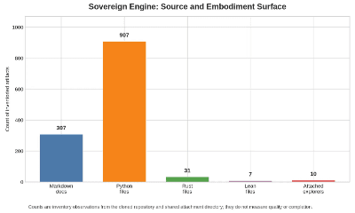
10 / IMPLEMENTATION ROADMAP
Development follows a staged verification spine
Build the smallest deterministic kernel first, then add geometric operators, provenance, interfaces, and GU-specific hypothesis modules only when their contracts are explicit.
Evidence of breadth
The repository inventory shows a broad experimental surface across documentation, Python, Rust, Lean, and attached explorers. Counts indicate artifact volume, not completion or quality.
T0
T1
T2
T3
Canonical AST
Typed tensors
Connections + curvature
Forms + gauge
Stable IDs, canonical JSON, expression trees, source spans.
Variance, slots, dimensions, signatures, contractions.
Metric, Levi–Civita, torsion, Riemann, Ricci, Einstein.
Wedge, d, D, Hodge star, F, Bianchi checks.
→
→
→
↘
T4
T5
T6
T7
Spinor interface
Evidence ledger
Logos + Monad
GU hypotheses
Clifford relations, Dirac operators, spectral obligations.
Claims, sources, assumptions, replay, immutable hashes.
Plain-language explanations and deterministic state transitions.
Versioned actions and representations; missing proofs stay unresolved.
RELEASE GATE
FAILURE POLICY
A feature is releasable only when schemas, identities, numerical fixtures, serialization, and cross-language parity pass.
Unknown operations and incomplete GU definitions return unverifiable, never a plausible guess.
SOVEREIGN ENGINE / 11
Notes:
Development follows a staged verification spine that builds the smallest deterministic kernel first. We start at tier zero with canonical abstract syntax trees and move through typed tensors, connections, curvature, and differential forms. Spinor interfaces and evidence ledgers come next, followed by logos adapters and versioned geometric unity hypothesis modules. Our failure policy is absolute. Unknown operations and incomplete definitions return unverifiable rather than a plausible guess. Let's examine how this translates to our final guiding principle.

Slide 12

11 / CLOSING PRINCIPLE
The meaning layer’s final promise
[
Geometry does not make every statement true. It makes representations, transformations, assumptions, and evidence inspectable.
→
→
→
Representation
Transformation
Assumptions
Evidence
Every object has an
Every change names its
Every physical or GU-
Every result is
identity, type,
operation, inputs,
specific interpretation
replayable as verified,
dimension, and context.
outputs, and preserved
declares its evidence
failed, or unverifiable.
invariants.
boundary.
Sovereignty means: identity, provenance, verification, operational independence, and human interpretability.
Next milestone: build the reproducible tensor kernel before making stronger theory-of-everything claims.
SOVEREIGN ENGINE / 12
Notes:
Geometry does not magically make every statement true. It makes representations, transformations, assumptions, and evidence fully inspectable. Sovereignty means identity, provenance, verification, operational independence, and human interpretability. Our next implementation milestone is building a reproducible tensor kernel before making any stronger theory of everything claims. Thank you for your time.

